Slide 1
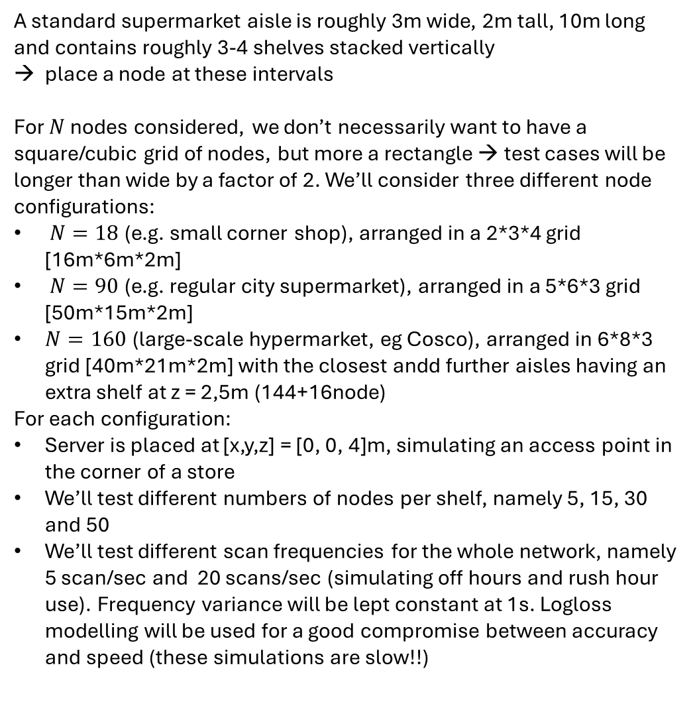
Shelf spacing and spatial test case configurations
Client node/shelf
A standard supermarket aisle is roughly 3m wide, 2m tall, 10m long and contains roughly 3-4 shelves stacked vertically
place a node at these intervals
For $N$ nodes considered, we don’t necessarily want to have a square/cubic grid of nodes, but more a rectangle → test cases will be longer than wide by a factor of 2. We’ll consider three different node configurations:
$N=18$(e.g. small corner shop), arranged in a 2*3*4 grid [16m*6m*2m]
$N=90$(e.g. regular city supermarket), arranged in a 5*6*3 grid [50m*15m*2m]
$N=160$(large-scale hypermarket, eg Cosco), arranged in 6*8*3 grid [40m*21m*2m] with the closest andd further aisles having an extra shelf at z = 2,5m (144+16node)
For each configuration:
Server is placed at [x,y,z] = [0, 0, 4]m, simulating an access point in the corner of a store
We’ll test different numbers of nodes per shelf, namely 5, 15, 30 and 50
We’ll test different scan frequencies for the whole network, namely 5 scan/sec and 20 scans/sec (simulating off hours and rush hour use). Frequency variance will be lept constant at 1s. Logloss modelling will be used for a good compromise between accuracy and speed (these simulations are slow!!)
Server node
Store walls
Inter-aisle
Spacing (~3m)
shelf length (~10m)
aisle
height (~2m)

Slide 2
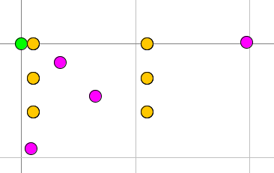
Disturbance
Shelf cluster head
Server
Store walls
Checkout
Physical store aisle
Store Entrance/Exit

